Slide 1
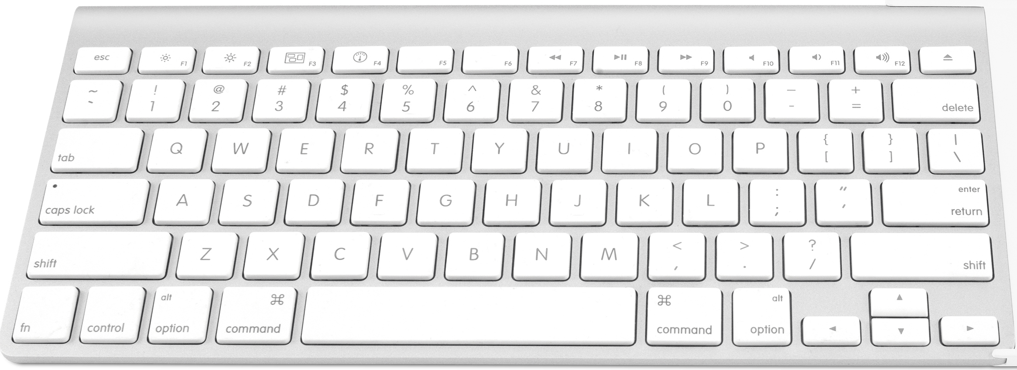
Listen CAREFULLY
Acoustic Keylogging Using Machine Learning
Scott Stevenson
@scottastevenson
scottstevenson88@gmail.com
Navid Shekoufa
@n6599
shekoufa.navid@gmail.com

Slide 2
1. KEYLOGGING

Slide 3
A keylogger is a type of surveillance software/hardware that records keystrokes a user makes.
They are often employed with the intention of stealing sensitive information such as passwords and credit card numbers.

Slide 4
Software Keyloggers
Incredibly common in the 2000s - 70% of enterprises infected with keyloggers in 2008
Completely undetectable in some OS’s
Virus protection got better - OS’s more resilient
But are still definitely out there…

Slide 5
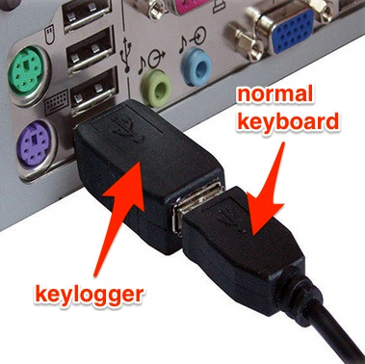
Hardware Keyloggers
Notes:
Highly effective in computer labs, corporate environments
How many times have you been at someones desk, faced with the back of their computer?

Slide 6
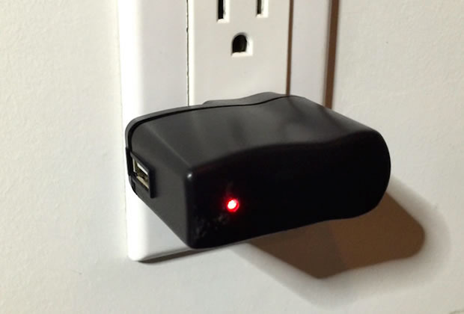
Hardware Keyloggers
Notes:
Wireless keyboards

Slide 7


Slide 8


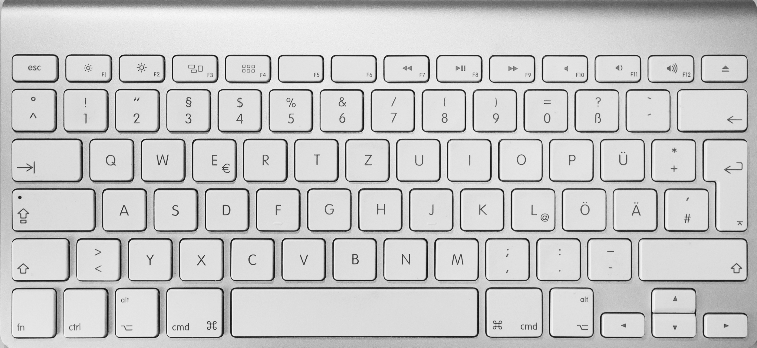

Slide 9
Three researchers (Li Zhuang, Feng Zhou, J. D. Tygar) demonstrated in their paper “Keyboard Emanations Revisited” that they could recover 96% of typed characters from a 10 minute recording of keyboard sounds.
An improvement on the seminal work by Asonov and Agrawal.

Slide 10
2. Machine Learning

Slide 11
Machine Learning
What is Machine Learning?
Major types of Machine Learning:
Reinforcement Learning
Unsupervised learning
Supervised Learning

Slide 12
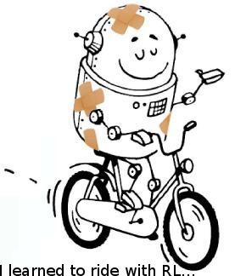
Reinforcement Learning
Inspired by behaviourist psychology
Applications

Slide 13
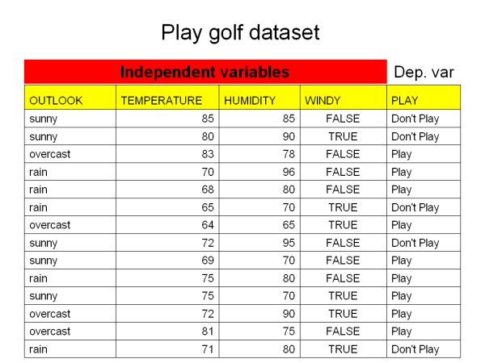
Datasets

Slide 14
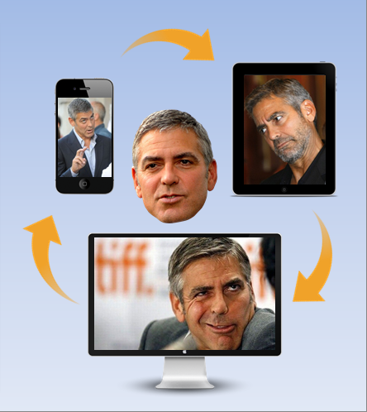
UNSUPERVISED Learning
Describes hidden structures
Applications

Slide 15
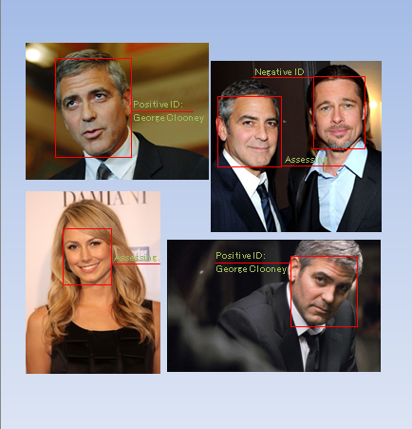
SUPERVISED Learning
Infers a function from labeled training data
Training is involved
Applications

Slide 16
Acoustic KEYLOGGER
Speech recognition is mostly a supervised learning process
What would be the dataset in our demonstration?
What would be the learning process?

Slide 17
Neural Networks
Loosely modelled after the neuronal structure of the mammalian cerebral cortex
A large ANN might have hundreds or thousands of processor units
A mammalian brain has billions of neurons
Complex mathematics involved
Can rather easily gain an operational understanding of the operation

Slide 18
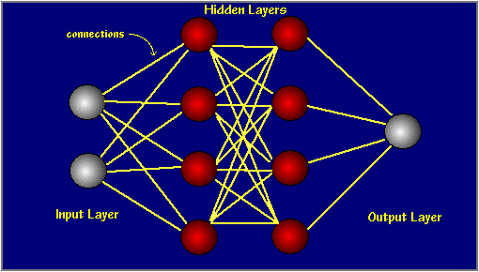
Neural Networks
Typically organized in layers
Each node in each layer has an activation function
Patterns are presented to the network via the input layer
Actual processing is done in the hidden layer
processing is done via a system of weighted connections
ANNs contain some form of learning rule to update the weights
ANNs learn by example, as a child learns to recognize dogs from examples of dogs

Slide 20
Challenges
What are the challenges?
Assumptions = Deviation from real world
Bias
Keeping the model simple

Slide 21
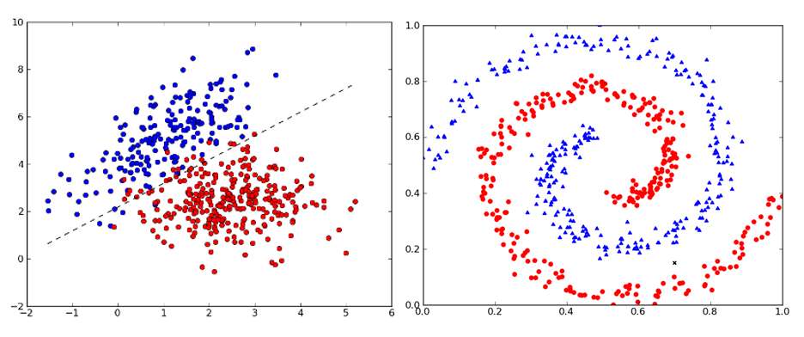
Challenges

Slide 22
Challenges
What are the challenges?
Assumptions = Deviation from real world
Bias
Keeping the model simple

Slide 23
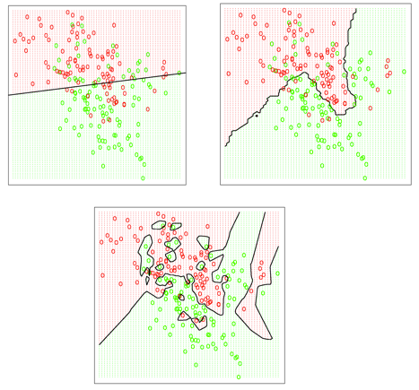
Challenges

Slide 24
3. Acoustic Keylogger

Slide 25
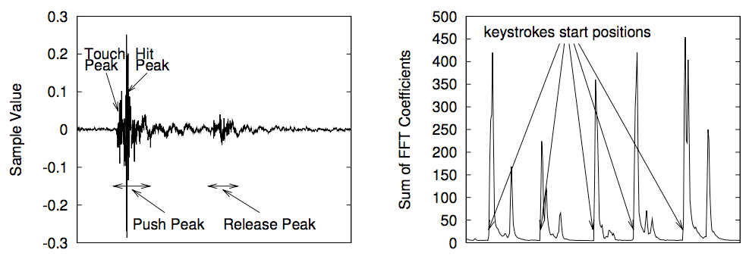
Sample Data

Slide 26
Demo!
Notes:
Supervised learning

Slide 27
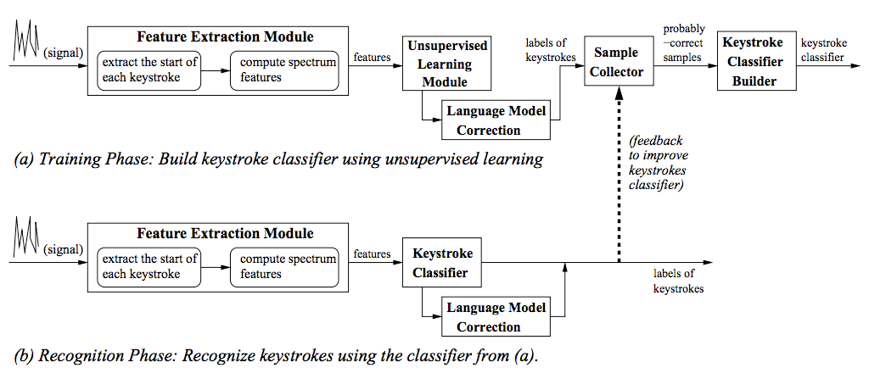
Unsupervised Method
Notes:
Autocorrect

Slide 28
Acoustic KEYLOGGER
Future direction
Dealing with noise, before training
Signal amplification
Introducing enough independent variables
Preparing a more comprehensive training dataset

Slide 29
Real world Attack Vectors
iPhone in hand or on table
Recording over conference call
Skype
Hidden microphone/contact microphone
Directional microphone in public space
Notes:
Don’t need a recording studio :)
iPhone Accelerometer

Slide 30
Thanks!
Scott Stevenson
@scottastevenson
scottstevenson88@gmail.com
Navid Shekoufa
@n6599
shekoufa.navid@gmail.com
meetup.ndev.co
slack.ndev.co

